Slide 1

HEY
WAKE UP!
VITO
RAY
Smart Jump Rope for Cardio Workout
DESIGNED BY IBOTU
DESIGNED BY IBOTU
3-C
Han Jiarui, Song Junni, Liu Yahui, Chai Haochen, Zhang Youzhi
DO SOME
THINGS!

Slide 2
HEY
WAKE UP!
VITO
RAY
Contents
01
Introduction
02
Aims and Objectives
DESIGNED BY IBOTU
DESIGNED BY IBOTU
03
Background
Materials and methods
04
05
Disscussion
06
Conclusion
DO SOME
THINGS!

Slide 3
HEY
WAKE UP!
VITO
RAY
PART .01
DESIGNED BY IBOTU
Introduction
DESIGNED BY IBOTU
DO SOME
THINGS!

Slide 4

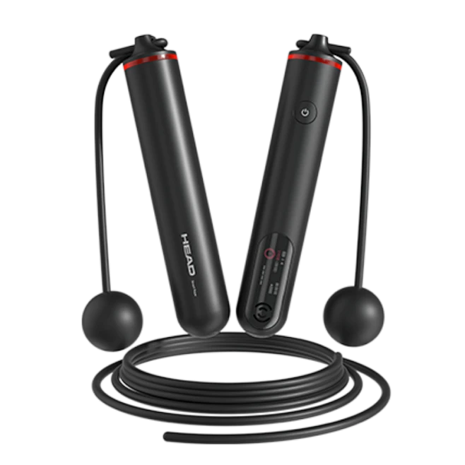
PART.01
Introduction to smart rope
Jumping rope is an effective aerobic exercise that can burn approximately 12 calories per minute for a person weighing 150 lbs (about 68 kg),[1]
Do not provide real-time workout data
Design a smart jump rope so that it can calculate the calories burned by jumping rope while recording data
[1] Kim, Y., and H. Shin, "Design and implementation of smart jump rope system using mobile and IoT technologies," International Journal of Smart Home, vol. 12, no. 3, pp. 25-34, 2018.
VITO
RAY

Slide 5
HEY
WAKE UP!
VITO
RAY
PART .02
Aims
and
Objectives
DESIGNED BY IBOTU
DESIGNED BY IBOTU
DO SOME
THINGS!

Slide 6
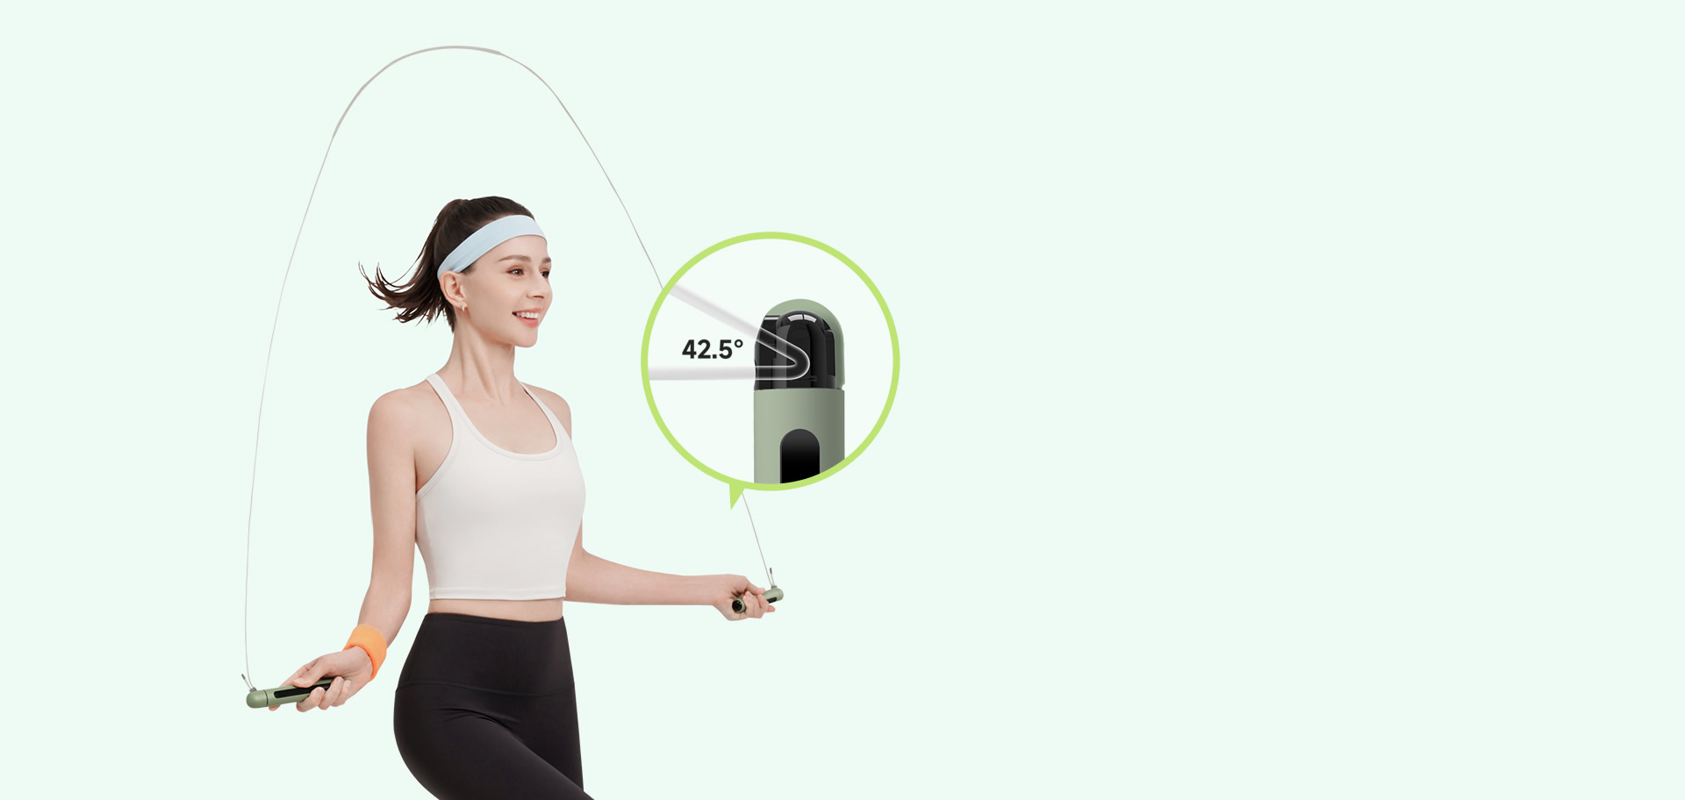
PART.02
Aims and Objectives
measures the number of jumps and calories burned
Jump rope enthusiasts:
Creating personalized fitness plans
Social interaction
Recovery patients:
Rehabilitation training
Monitoring health status
VITO
RAY

Slide 7
HEY
WAKE UP!
VITO
RAY
PART .03
DESIGNED BY IBOTU
Background
DESIGNED BY IBOTU
DO SOME
THINGS!

Slide 8
PART.03
Background
Modern smart jump ropes can synchronize data with health monitoring devices or smartwatches, providing personalized fitness advice and training plans.
Skipping rope served as a traditional aerobic exercise method.
The first generation of smart jump ropes are capable of accurately measuring users' jump counts and frequencies.
VITO
RAY

Slide 9
HEY
WAKE UP!
VITO
RAY
PART .04
DESIGNED BY IBOTU
Materials and Methods
DESIGNED BY IBOTU
DO SOME
THINGS!

Slide 10
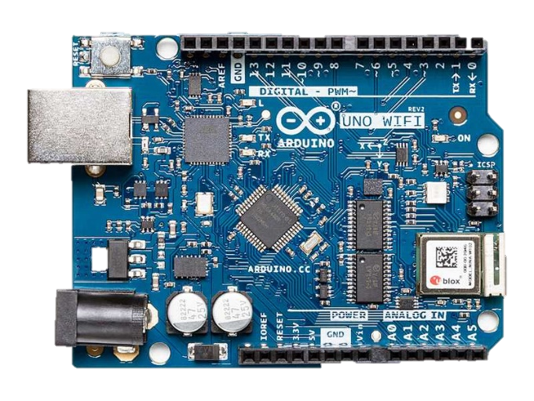
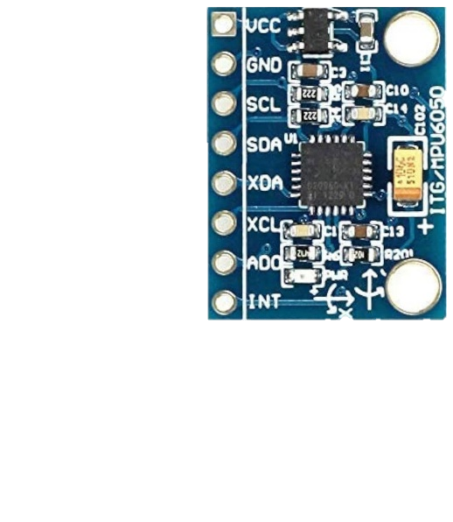
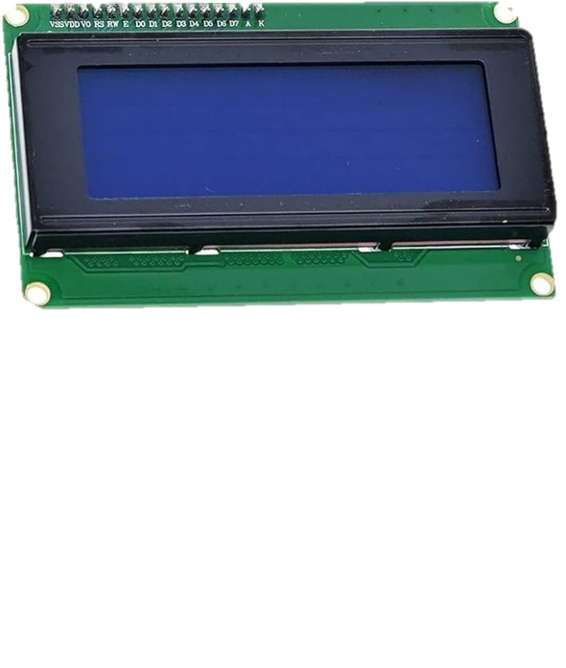
PART.04
Materials
MPU 6050
Arduino UNO
LCD display
VITO
RAY
PPT模板 http://www.1ppt.com/moban/

Slide 11
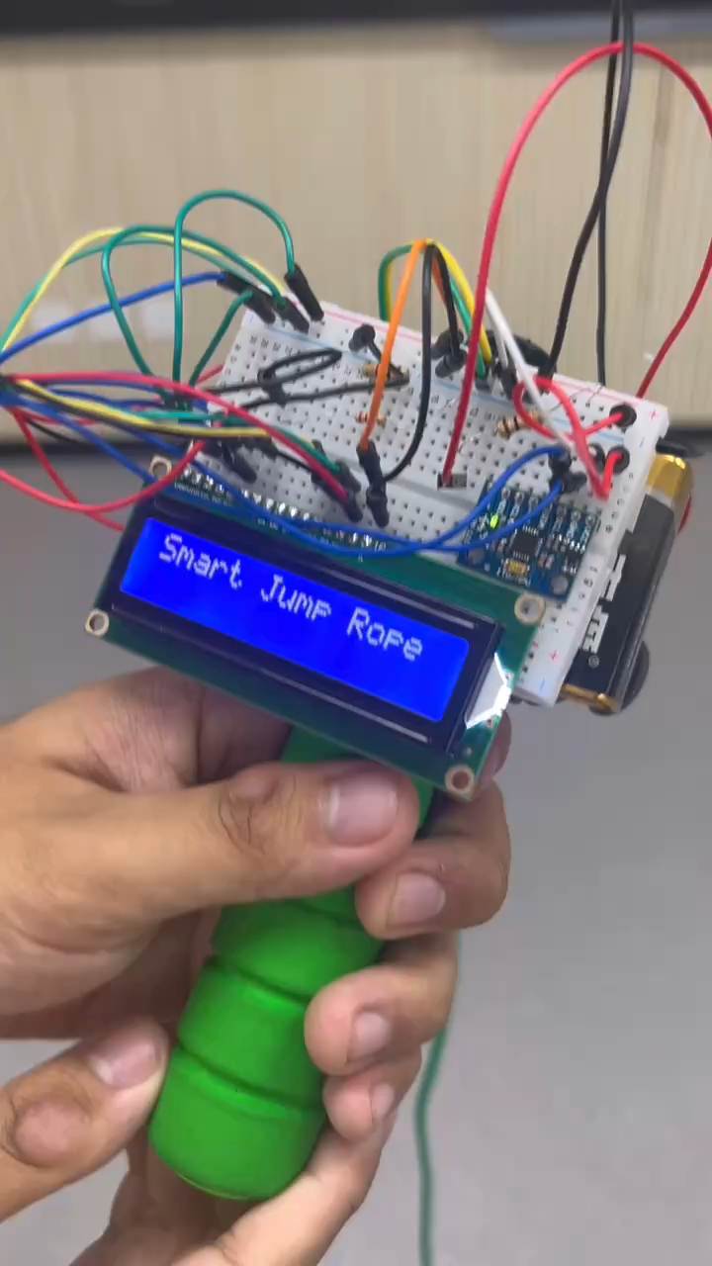
PART.04
Methods
1，UI & LCD
Automatically switches to the weight selection screen, where the user selects their weight category using the joystick.
The user confirms the selection by pressing the joystick button, entering the jump rope state.
In the jump rope state, the counter and timer start, and the LCD updates the data in real-time.
The user presses the joystick button to stop jumping, transitioning to the jump rope end state.
- In the jump rope end state, the LCD displays the jump count, elapsed time, calories burned, and BPM (jumps per minute).
VITO
RAY

Slide 12
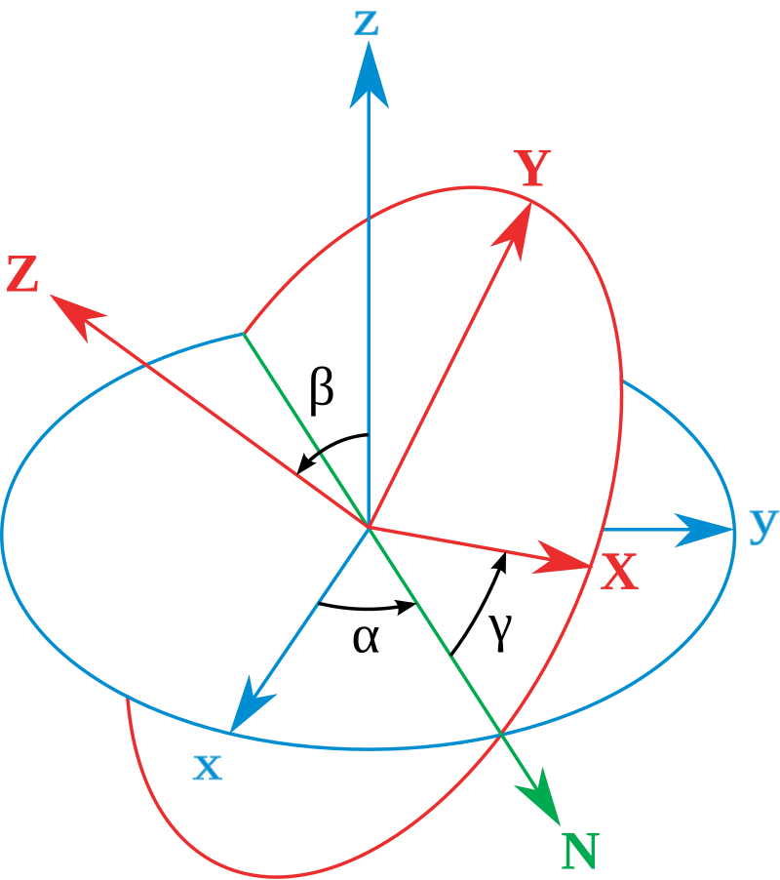
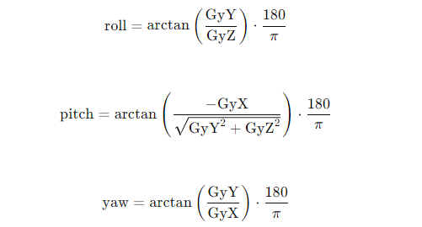
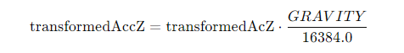
PART.04
Methods
2，algorithm for coordinate
VITO
RAY

Slide 13
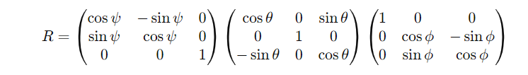
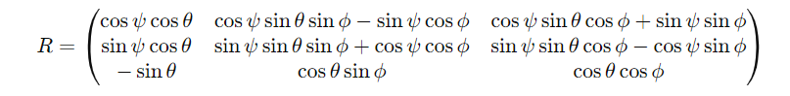
PART.04
Methods
2，algorithm for coordinate
Reference： Lionel Brits - Hand drawn in Inkscape by me，CC BY 3.0，https://commons.wikimedia.org/w/index.php?curid=3362239
VITO
RAY

Slide 14
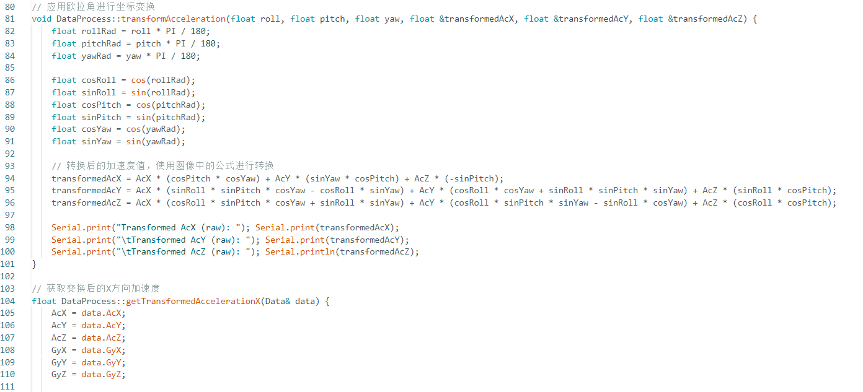
PART.04
Methods
2，algorithm
VITO
RAY

Slide 15
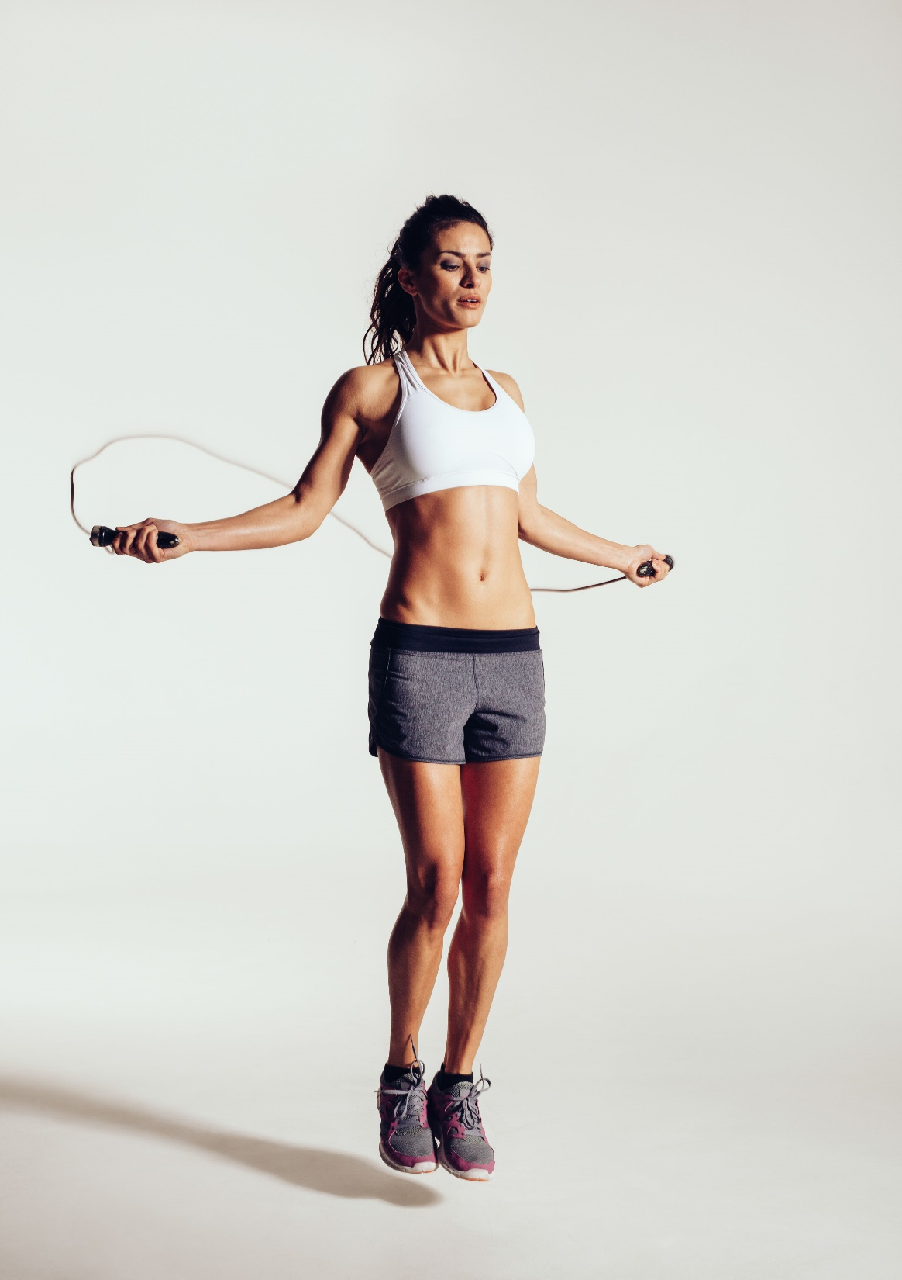
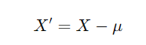
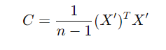
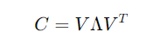
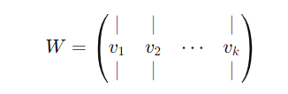
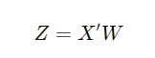
PART.04
Methods
Z
3，algorithm for angular acc
Trans t
VITO
RAY

Slide 16
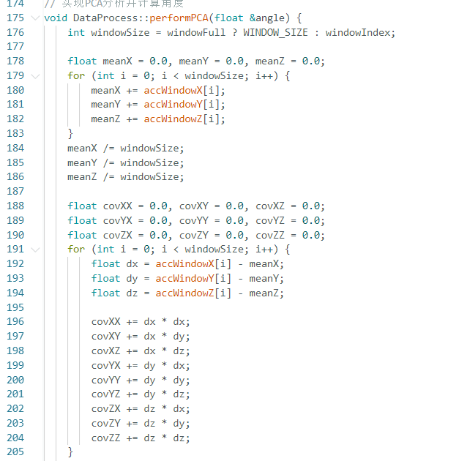
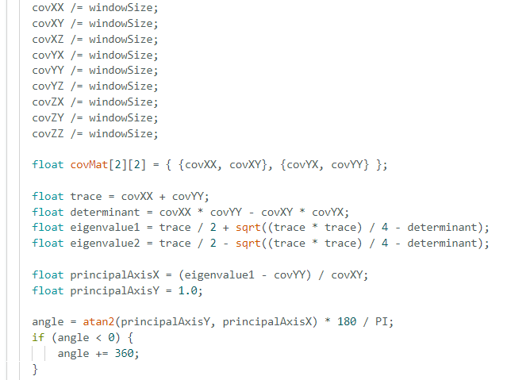
PART.04
Methods
2，algorithm
VITO
RAY

Slide 17
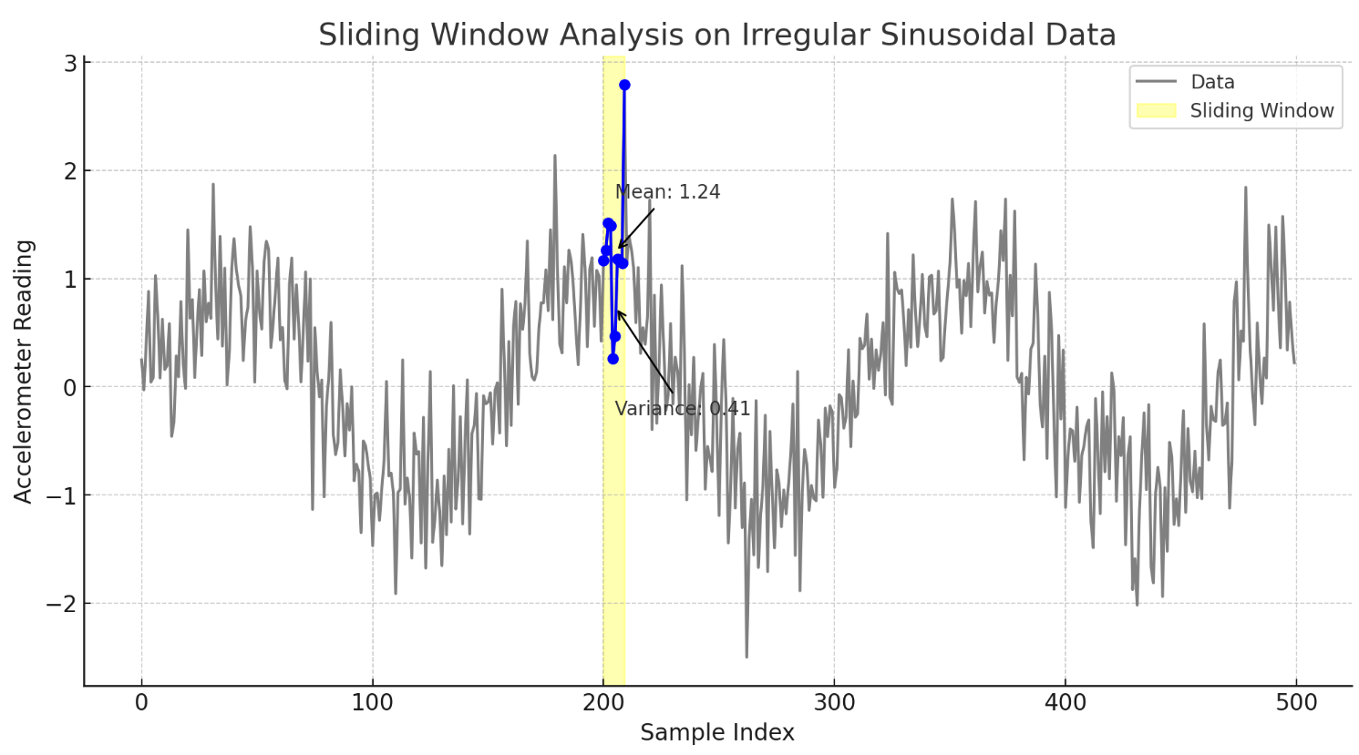
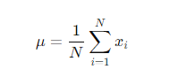
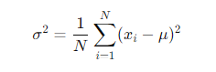
PART.04
the sliding window is used to analyze accelerometer data over a set number of samples, defined by WINDOW_SIZE (10 samples). The window collects the most recent accelerometer readings, and as new data comes in, the oldest data point is replaced. This moving subset of data is then used to calculate the mean and variance, helping to smooth out noise and detect significant events like jumps. The window "slides" forward with each new data point, continuously updating the analysis.
Methods
3，algorithm for signal processing
THES:
mean = 12.7475
variance = 13.798
VITO
RAY

Slide 18
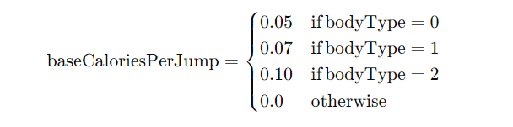
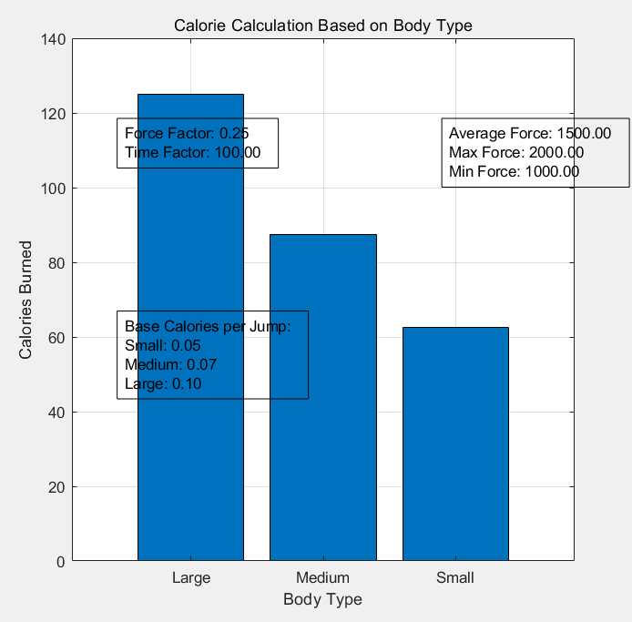
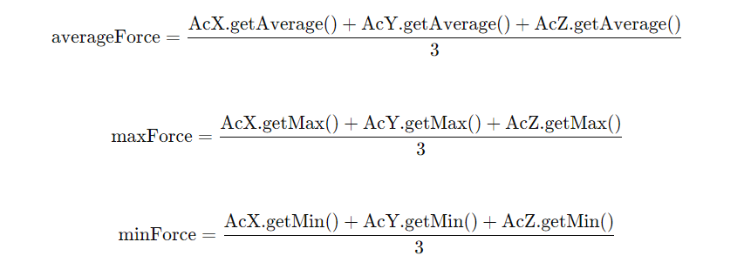
1.Base Calories Burned per Jump: Determine the base calories burned per jump (baseCaloriesPerJump) based on the body type.
PART.04
Methods
3，Calorie
2.Calculate Average, Maximum, and Minimum Forces: Assume the accelerometer data for X, Y, Z axes are AcX, AcY, AcZ.
VITO
RAY

Slide 19
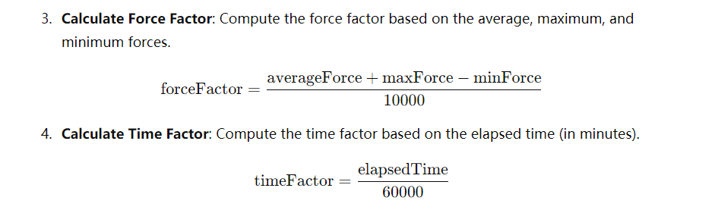
PART.04
Methods
3，Calorie
VITO
RAY

Slide 20
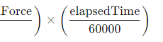
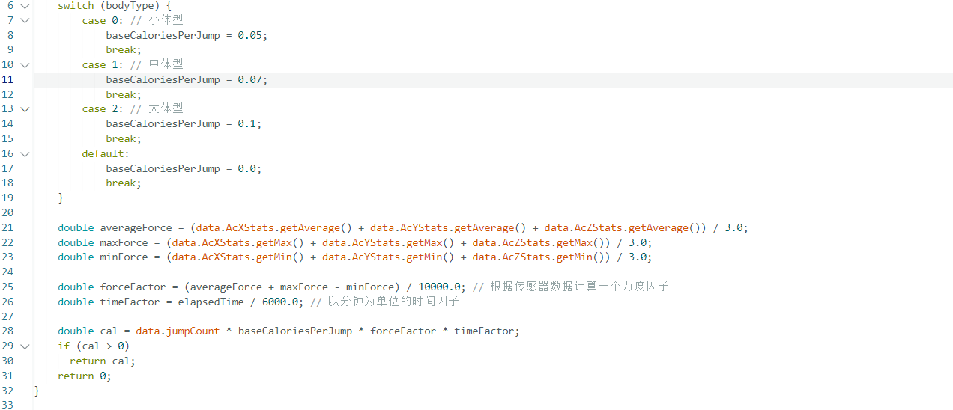
PART.04
Methods
3，Calorie
VITO
RAY

Slide 21
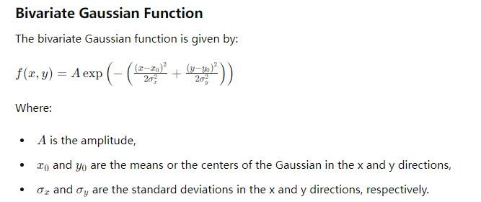
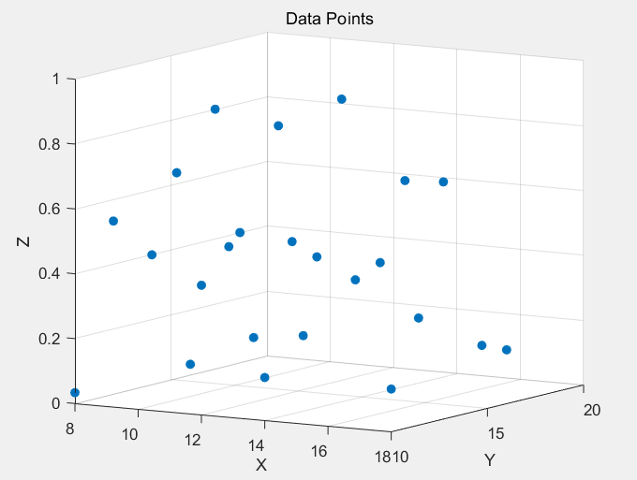
PART.04
Results & data annalists
VITO
RAY

Slide 22
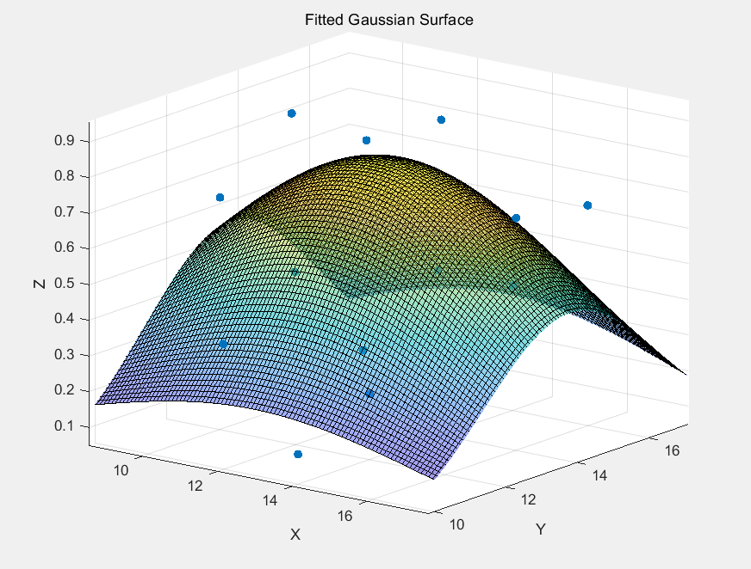
PART.04
Results & data annalists
mean = 12.7475
variance = 13.798
Acc = 97.67%
VITO
RAY

Slide 23
HEY
WAKE UP!
VITO
RAY
PART .05
DESIGNED BY IBOTU
Discussion
DESIGNED BY IBOTU
DO SOME
THINGS!

Slide 24
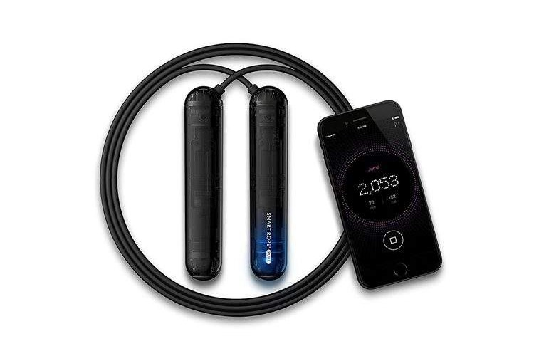
PART.05
1
Implications
Discussion
Motivation and Accountability
Health Monitoring
2
Strengths
Accuracy and Precision
Convenience
3
Limitations
Assumption of Homogeneity
Proper Usage
External Factors
VITO
RAY

Slide 25
HEY
WAKE UP!
VITO
RAY
PART .06
DESIGNED BY IBOTU
Conclusion
DESIGNED BY IBOTU
DO SOME
THINGS!

Slide 26

Conclusion
more sophisticated technology
Great effort by every member.
There are still outstanding issues that require resolution：
Personalization
the lack of accuracy in the calculation.
VITO
RAY

Slide 27
HEY
WAKE UP!
VITO
RAY
2024
THANKS
DESIGNED BY IBOTU
DESIGNED BY IBOTU
A SIMPLE AND NICE TEMPLATE HOPE YOU LIKE BY VITO RAY
3-C
DO SOME
THINGS!

